Slide 1
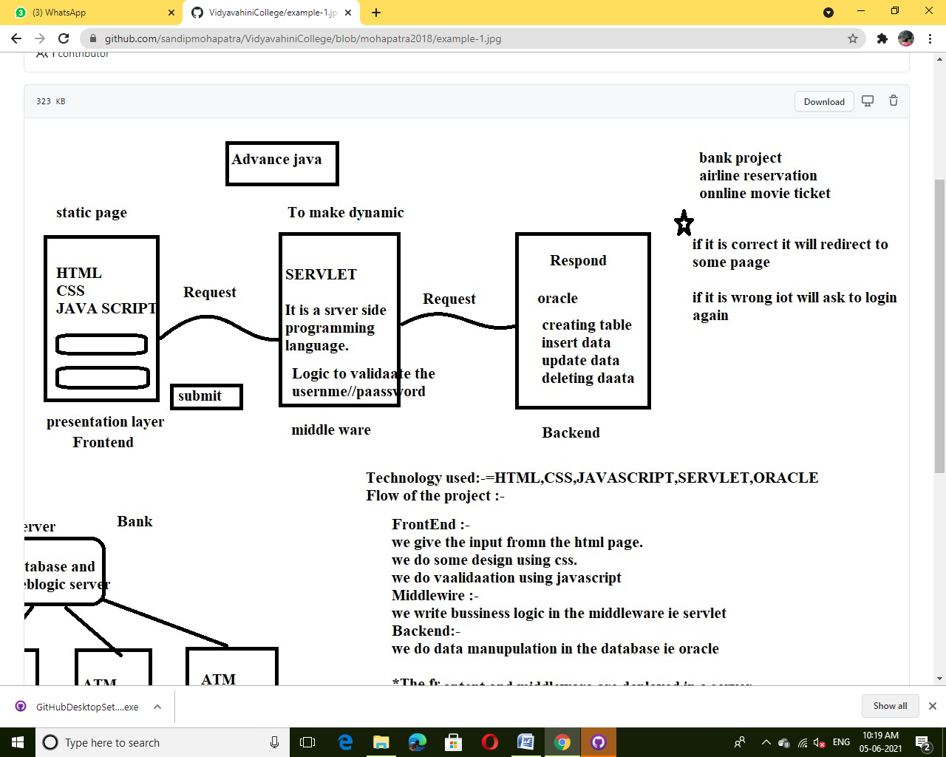
Flow of project:

Slide 2
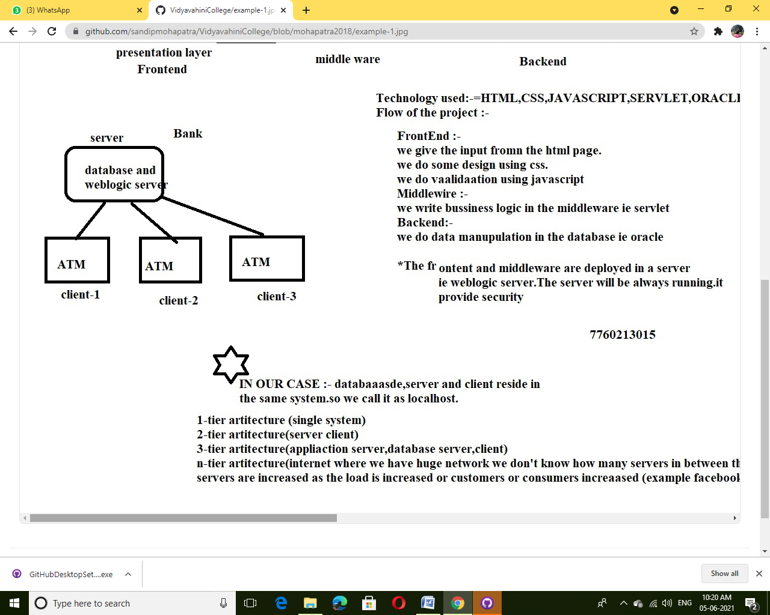

Slide 3
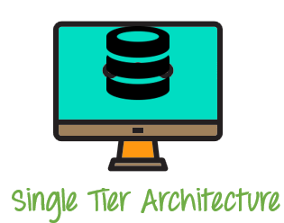
Tier Architecture:
Types of DBMS Architecture
There are mainly three types of DBMS architecture:
One Tier Architecture (Single Tier Architecture)
Two Tier Architecture
Three Tier Architecture
N Tier Architecture
1-Tier Architecture
1 Tier Architecture in DBMS is the simplest architecture of Database in which the client, server, and Database all reside on the same machine. A simple one tier architecture example would be anytime you install a Database in your system and access it to practice SQL queries. But such architecture is rarely used in production.

Slide 4
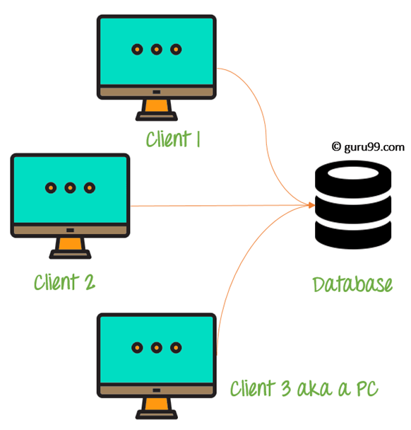
2-Tier Architecture
A 2 Tier Architecture in DBMS is a Database architecture where the presentation layer runs on a client (PC, Mobile, Tablet, etc.), and data is stored on a server called the second tier. Two tier architecture provides added security to the DBMS as it is not exposed to the end-user directly. It also provides direct and faster communication.
2 Tier Architecture Diagram

Slide 5
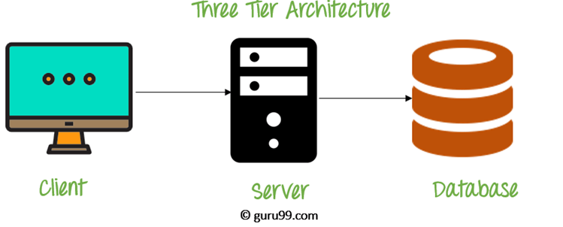
3-Tier Architecture
A 3 Tier Architecture in DBMS is the most popular client server architecture in DBMS in which the development and maintenance of functional processes, logic, data access, data storage, and user interface is done independently as separate modules. Three Tier architecture contains a presentation layer, an application layer, and a database server.3-Tier database Architecture design is an extension of the 2-tier client-server architecture. A 3-tier architecture has the following layers:
Presentation layer (your PC, Tablet, Mobile, etc.)
Application layer (server)
Database Server
3 Tier Architecture Diagram

Slide 6
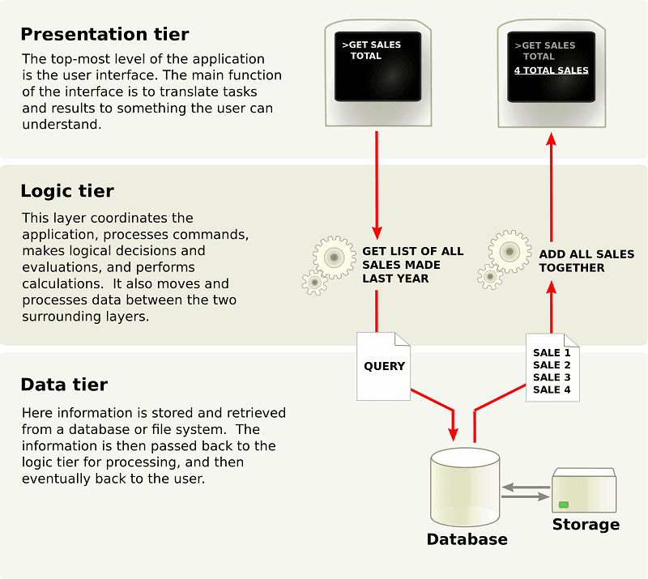
N-Tier Architecture
N-tier architecture would involve dividing an application into three different tiers. These would be the
logic tier,
the presentation tier, and
the data tier.

Slide 7
SYSTEM REQUIREMENTS:
Oracle Software
Eclipse Software
Platform811 Software
Installation of Oracle and eclipse Software in video format:

